Slide 1

Twitter Client
Mobile Apps Development
Ngô Sỹ Tùng Lâm
Trần Trọng Khánh
Tô Minh Sơn

Slide 2

Contents
Introduction
Review
Architecture
Activities
Optimization
Demo
Conclusion

Slide 3
Introduction - Twitter
Definition: a social networking and microblogging service.
Task: allows users to answer the question,
"What are you doing?“.
Method: sending short text messages 140 characters
in length, called "tweets", to users friends,
or "followers."

Slide 4
Introduction – Group project
What are we going to do:
A simple twitter user interface
User can sign in/ sign up
User can view timelines/ notifications
User can compose new tweet

Slide 5
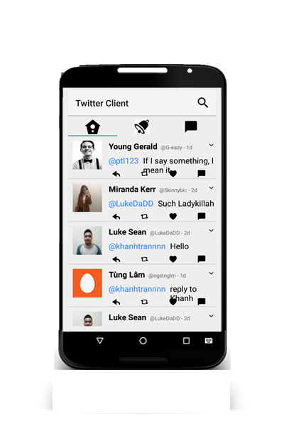
Review – What we did last time
Mid-term
Simple twitter client interface
Static information
2 main activities:
Log in
View home/notification/message

Slide 6
What we do next
We want to implement some Twitter basic functions
such as compose tweet, like or retweet,…
We used Fabric – The Twitter’s Software Development
Kit which utilizes Twitter API to do our task

Slide 7
Architecture
3 main activities:
Log in
Twitter activity
Composing new tweet activity
3 main fragments:
Home
Notification
Message

Slide 8
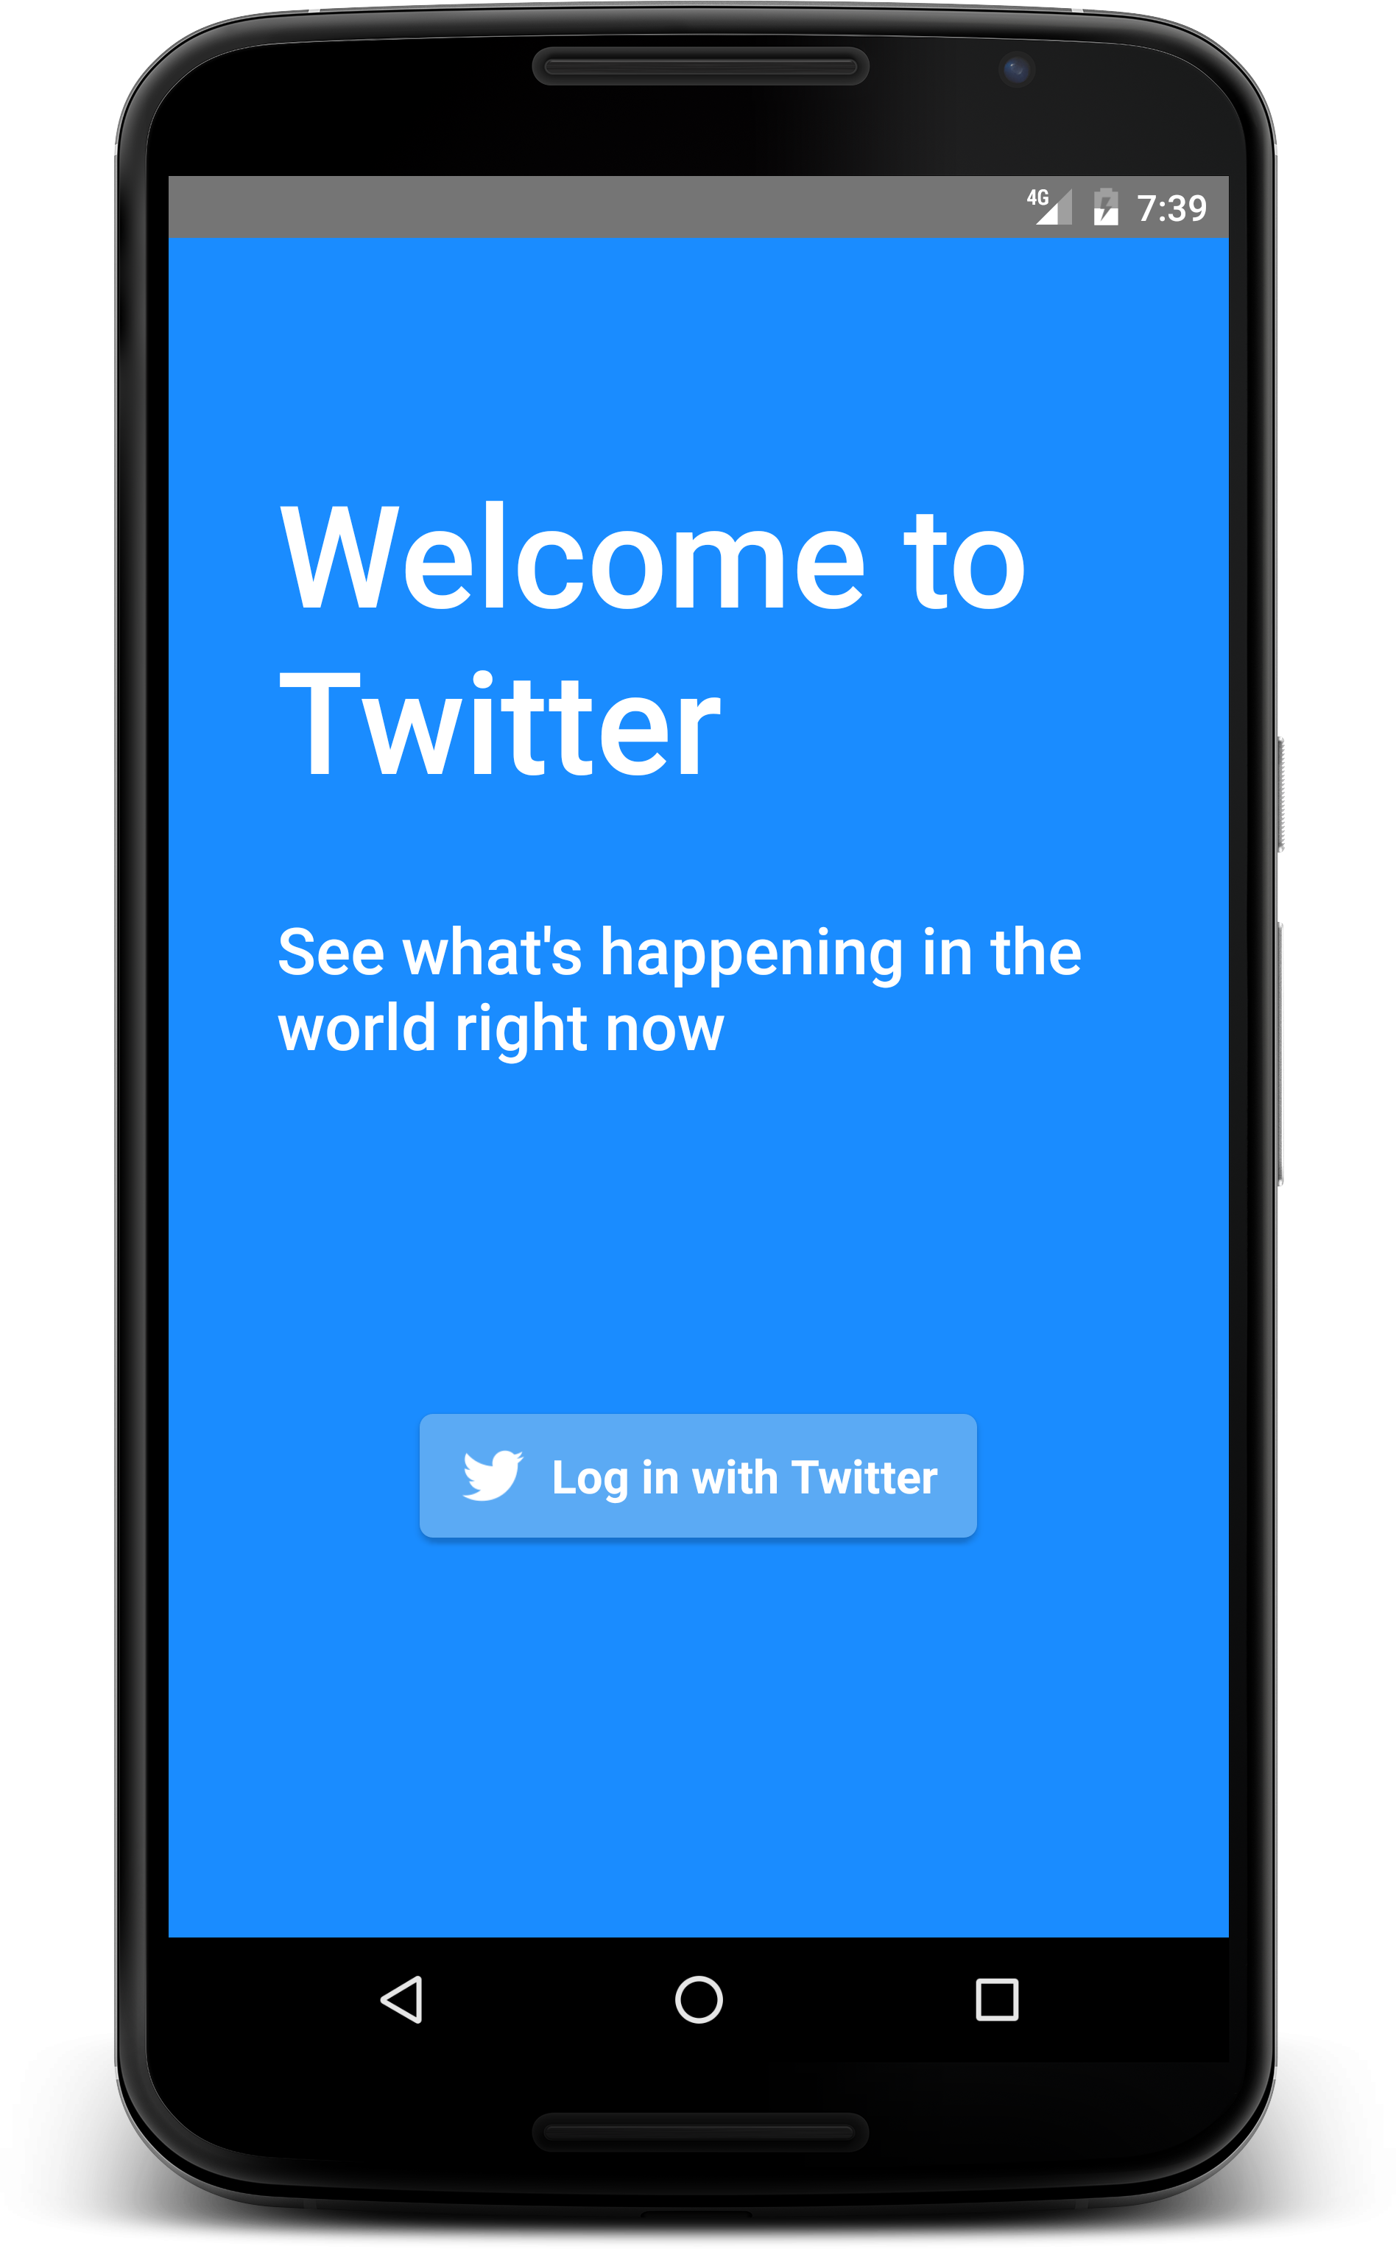
Launch page
A welcome page shows up
Press the login button to continue

Slide 9
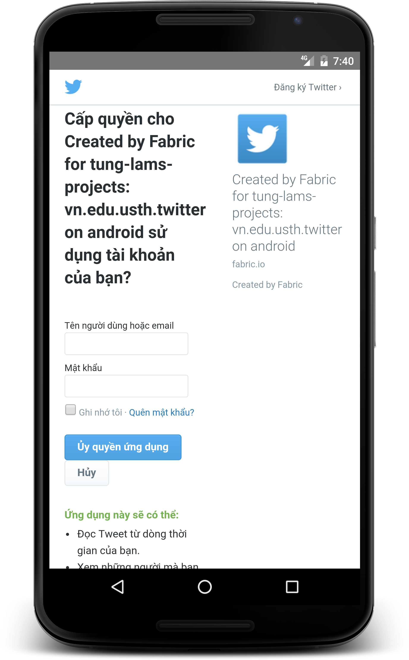
Log in activity
Confirmation from real twitter company
Enter user email and password to continue
User can also sign up in this page

Slide 10
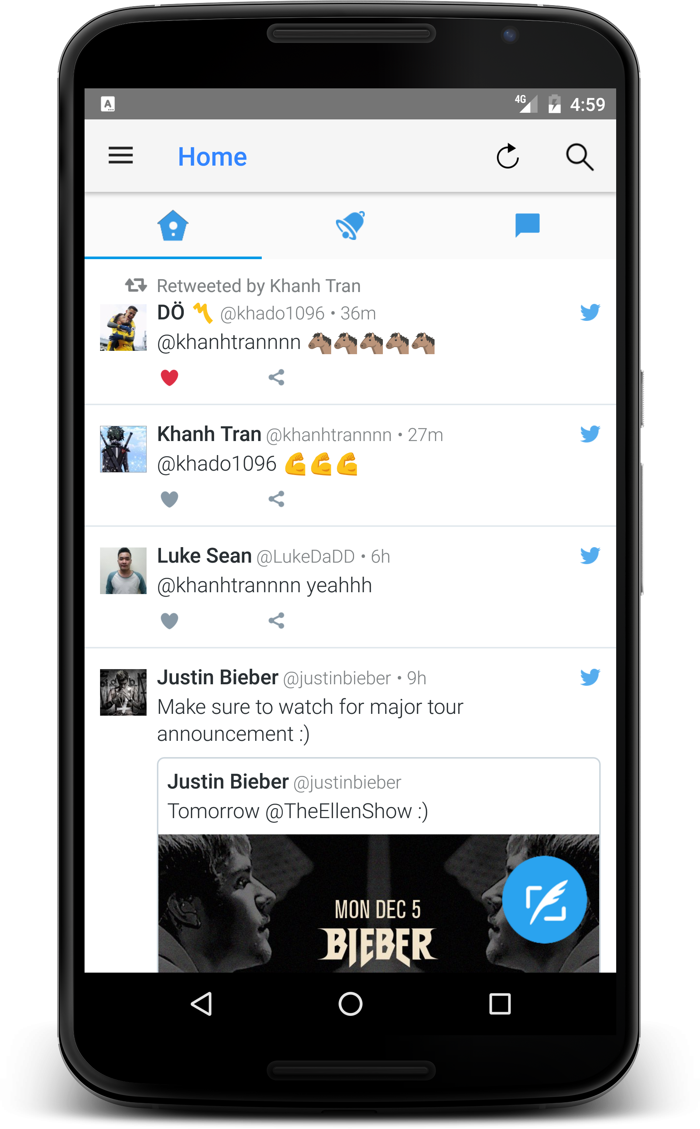
Twitter Activity – Homes
Show the most recent tweets of your following users.
2 basic functions:
Like
Load image/ video

Slide 11
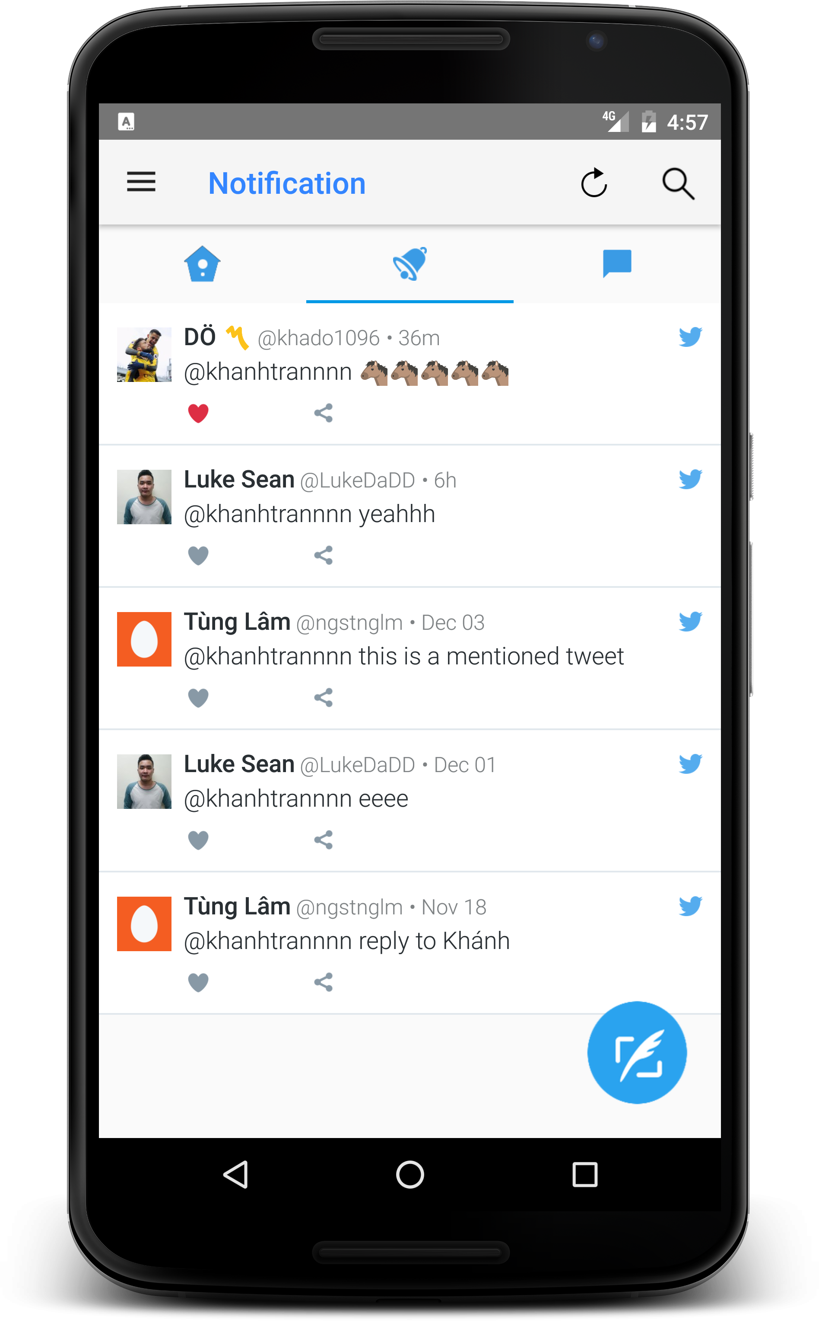
Twitter Activity - Notification
Show tweet, new follows
that are related to current user.
The toolbar title changes
according to the tab selected.

Slide 12
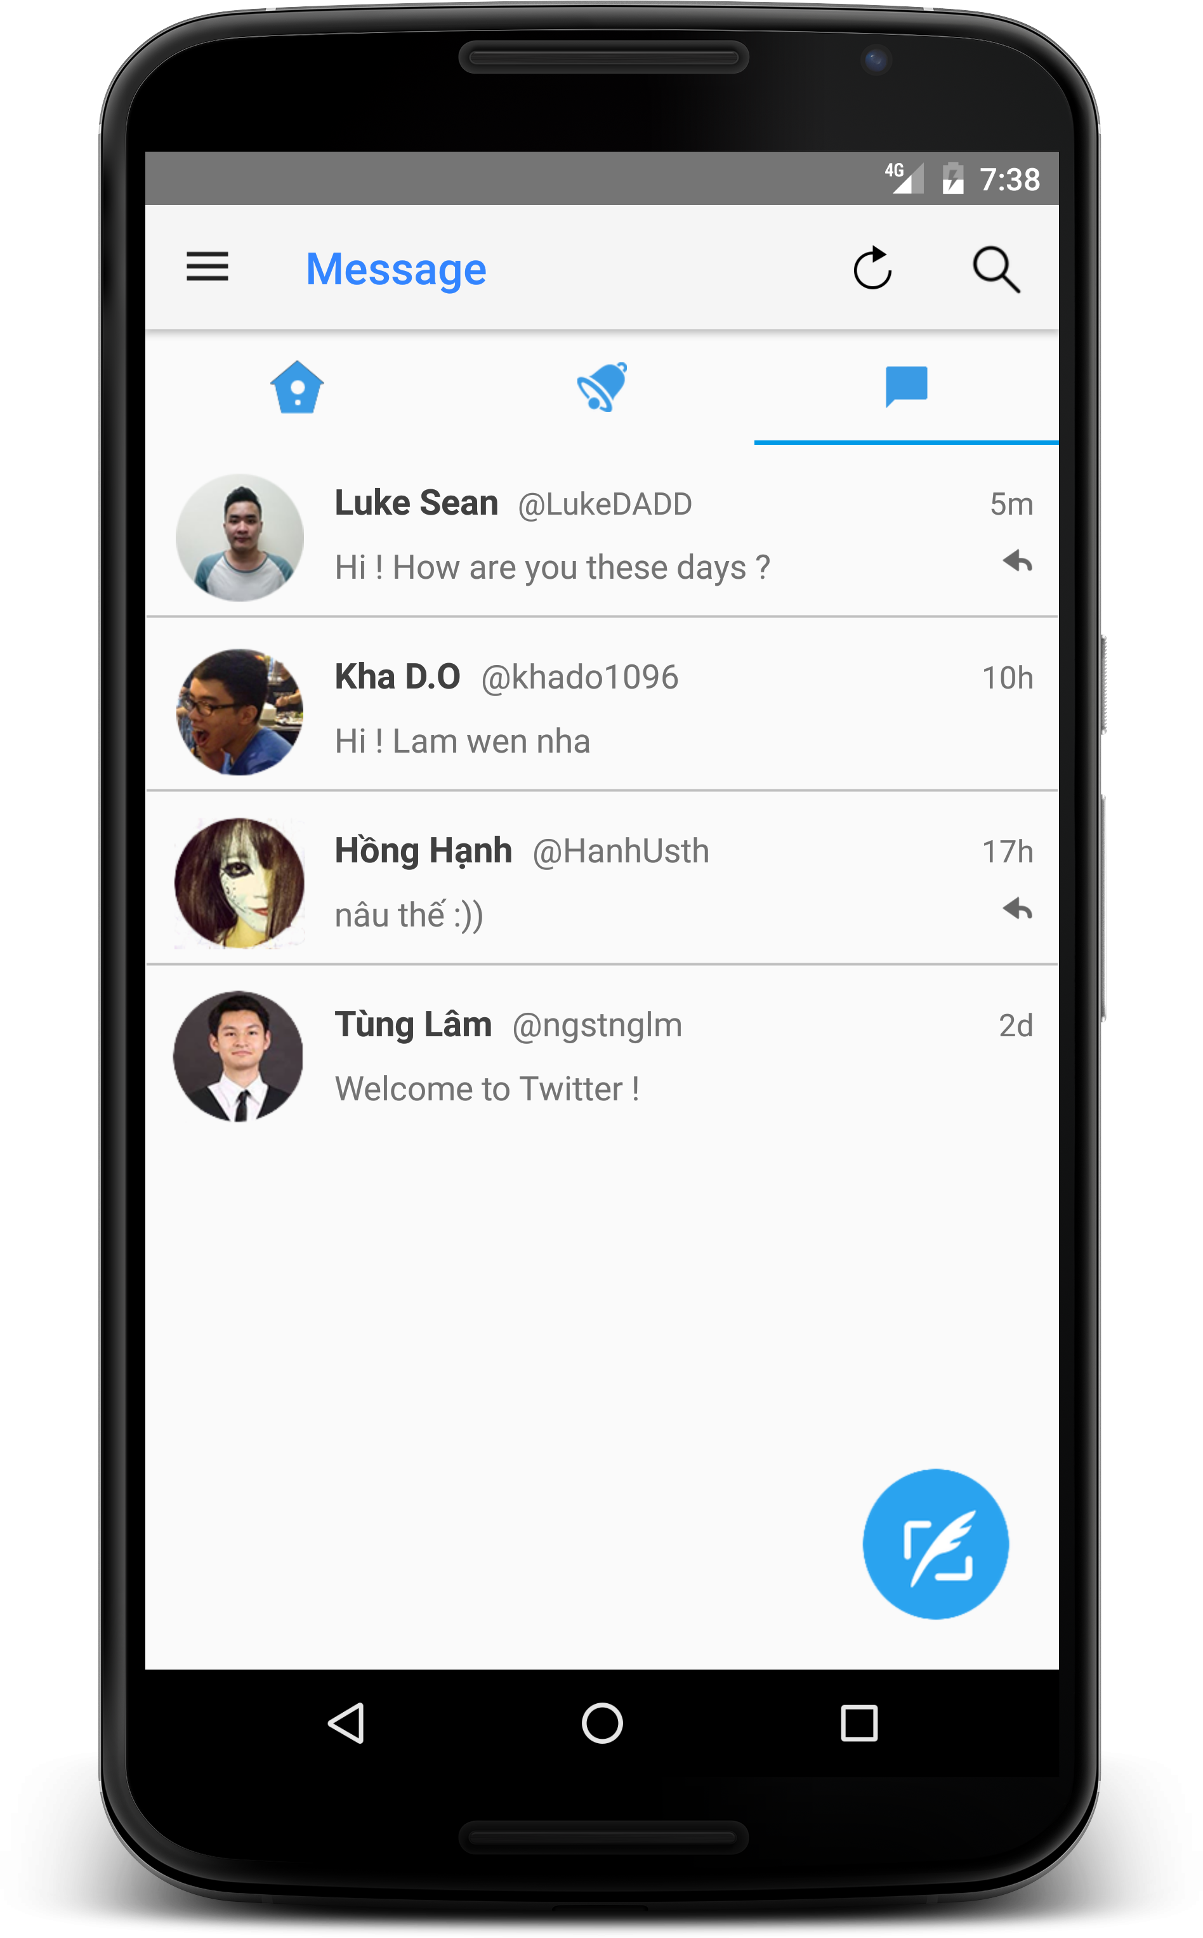
Twitter Activity - Message
Show private messages
of current user with other
user

Slide 13
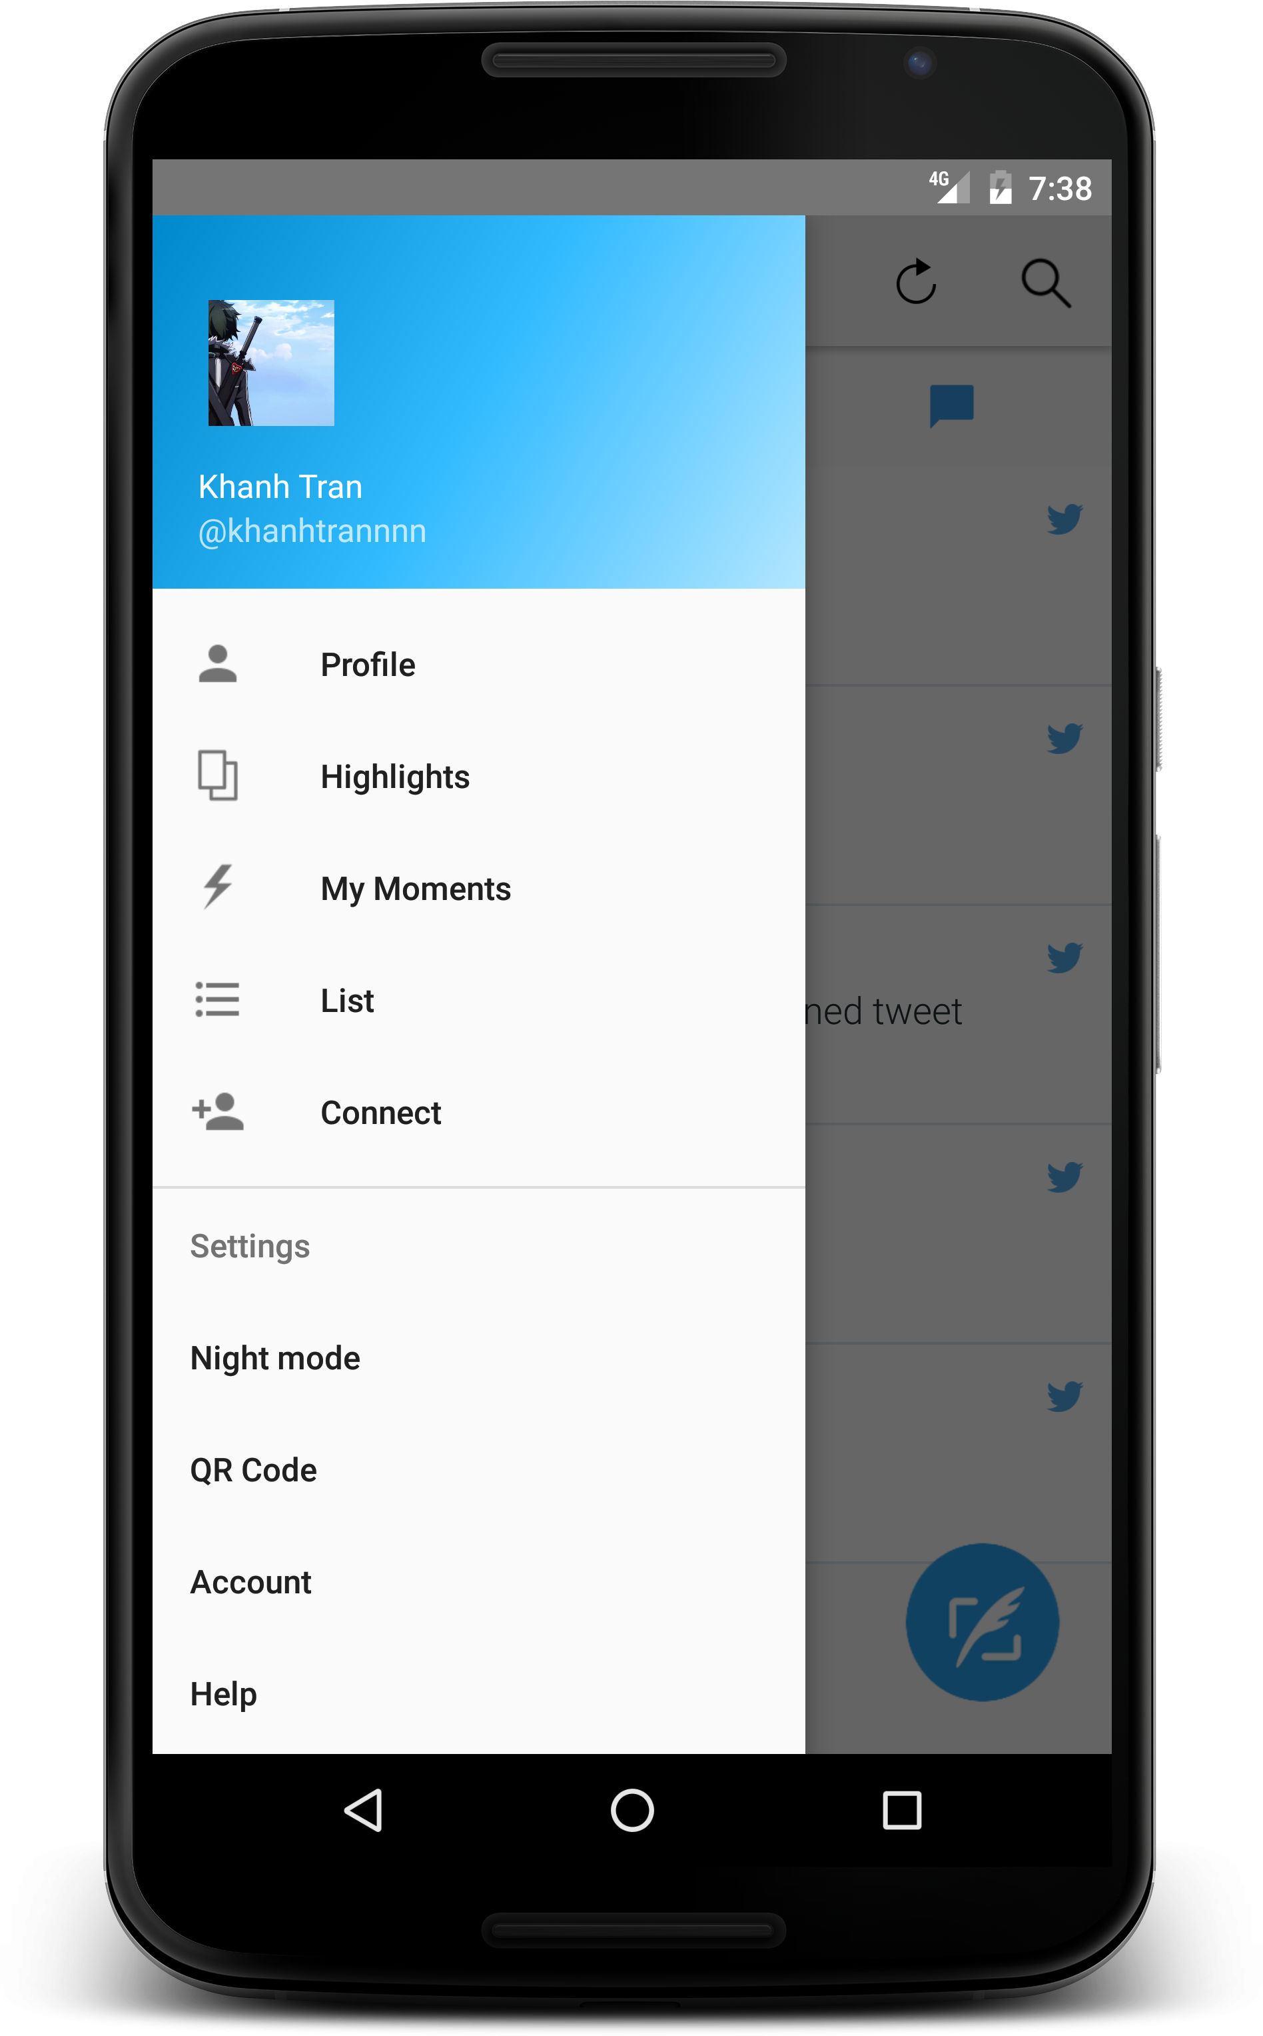
Navigation drawer
Header and content
Layout, static

Slide 14
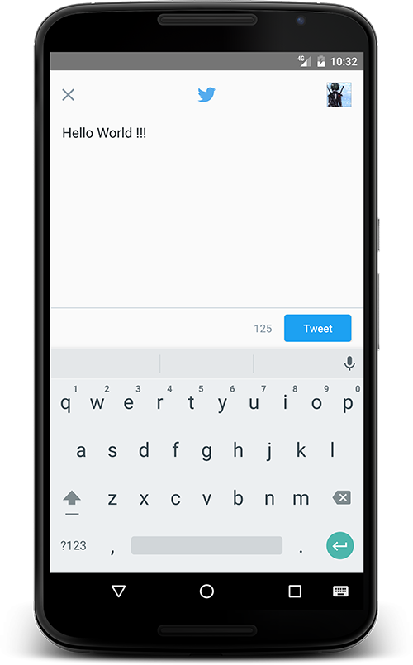

Compose new tweets
Press the button at the bottom right of the screen
Characters count down from 140.

Slide 15

Networking
Use Fabric – Twitter’s SDK, which utilizing
Twitter API.

Slide 16
Optimization
Refresh button => update new tweet in home page
Remove redundant images => no more laggy when scrolling
Splash screen while loading

Slide 17
Demo Time

Slide 18
Conclusion
We want to talk about our improvements compared to the last work

Slide 19
Improvements
Load real data from twitter
Compose new tweets directly
Better performance
Better looking UI

Slide 20
Thank you for listening!

